Slide 1
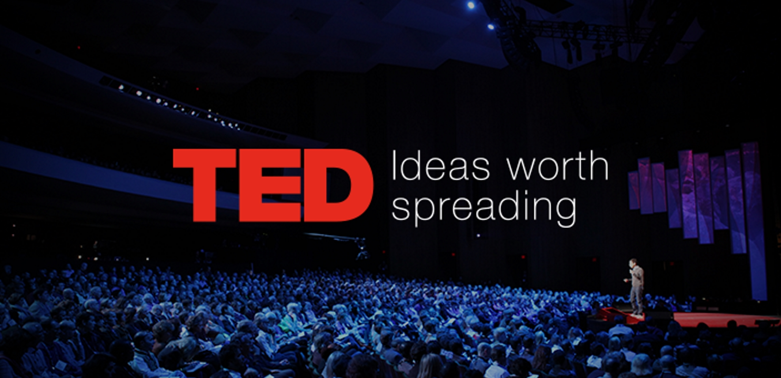
Analysis on TED Talks
HARSH PATEL
PARTH HINGU
PRIYAM SAXENA
SANJANA ATHREYA
VISHV BRAHMBHATT

Slide 2
AUDIENCE
OUR PROJECT AIMS AT -
Providing detailed analysis on which TED Talks have larger number of views, which talks create maximum debate.
Insights on the trending topics by analyzing which topic and which tags get the maximum views, comments and ratings.
Building a predictive model to analyze what factors affect the views for a video.
Ted Talk
Organizations that host Ted Talks
Speakers

Slide 3
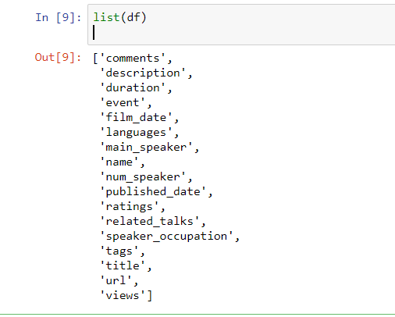
DATASET AND DATA DICTIONARY
The dataset that has been used for performing exploratory and predictive data analysis has been web scrapped from the official TED Talks website, www.ted.com
The analysis has been performed using two data sets. The main dataset contains all the details of the TED Talks along with its speakers.
The other data set, which contains the content of the speech in textual format.

Slide 4
DATA CLEANING AND EDA
Checking missing values and proper date time format conversion were done as part of cleaning
For EDA, we have found out relationship among various variables and also highlighted various factors that have high TED talk.
Lets look below some of them:

Slide 5
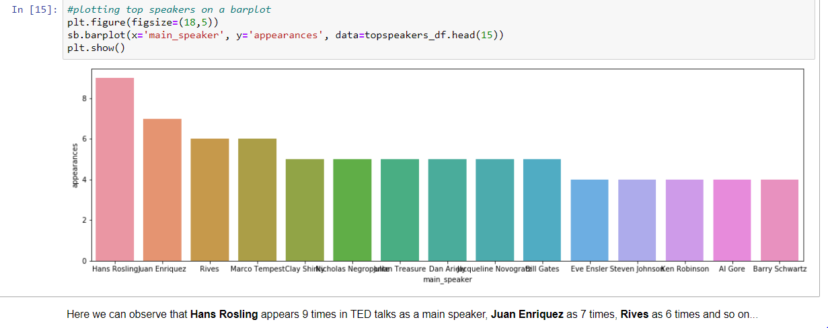
1) Which speaker has maximum talks?

Slide 6
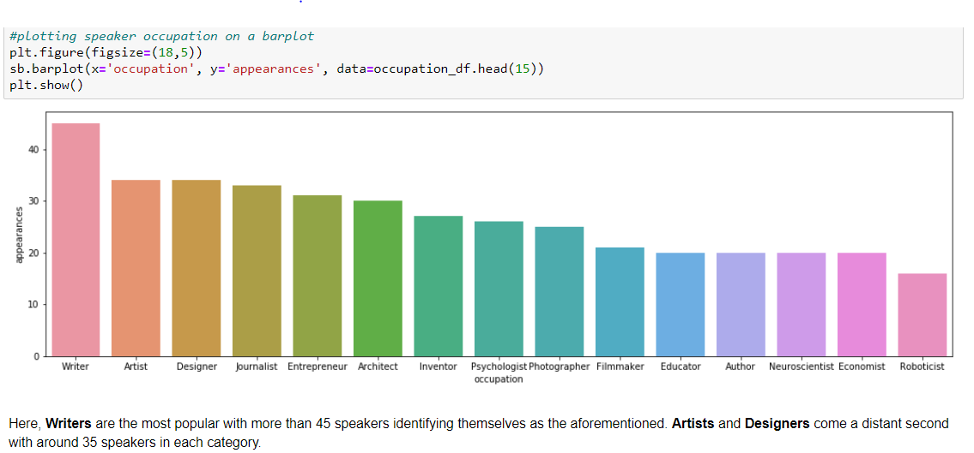
2) Speaker of which occupation is most popular among TED talks?

Slide 7
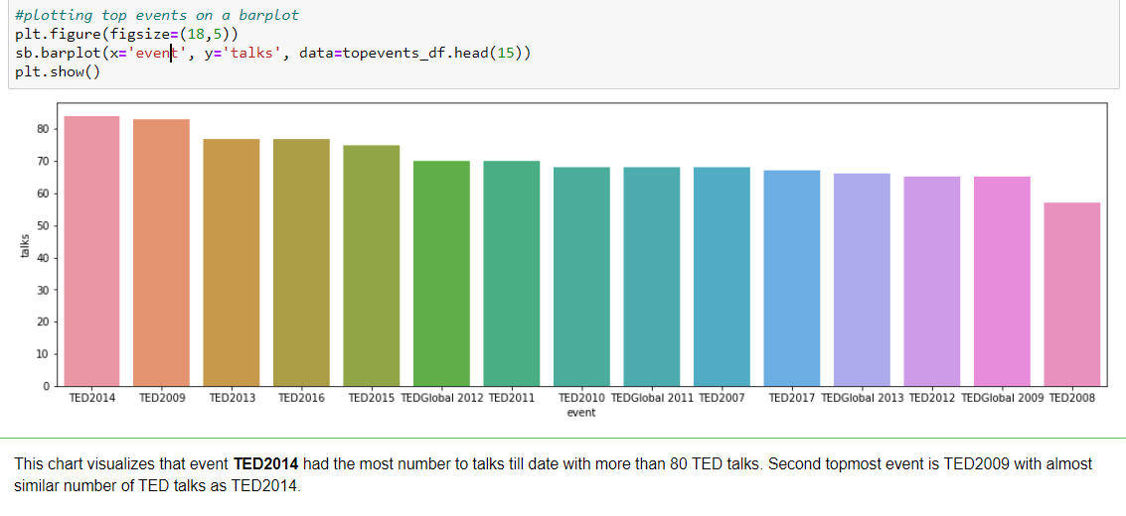
3) Which are most worthy event of TED talks?

Slide 8
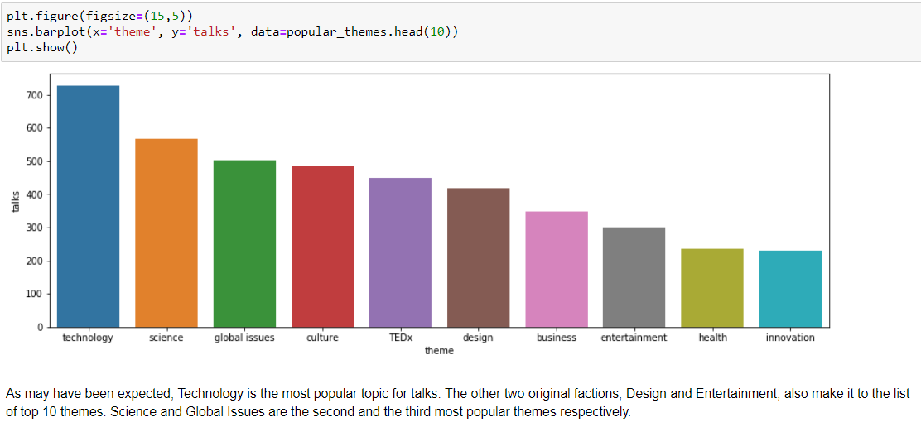
4) Which is the most popular theme of TED talks?

Slide 9
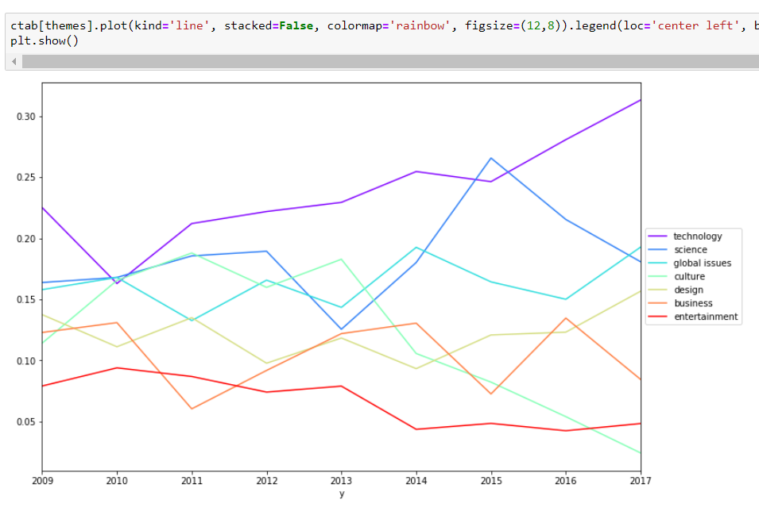
5) Which talks tend to attract the largest amount of discussion?

Slide 10
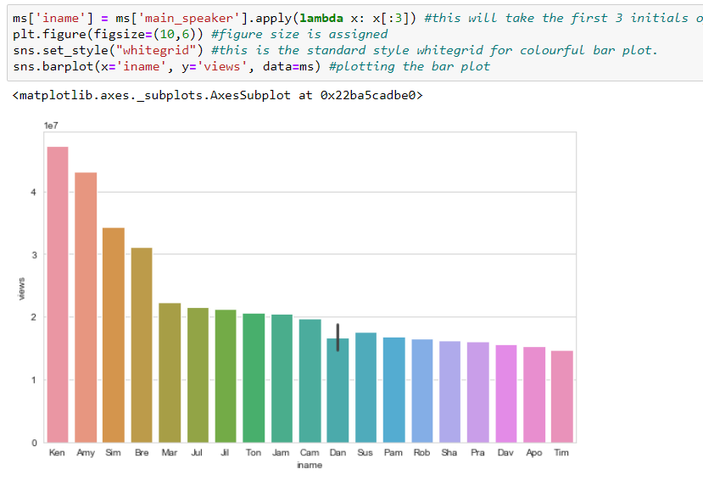
6) Which speaker has the most number of views?

Slide 11
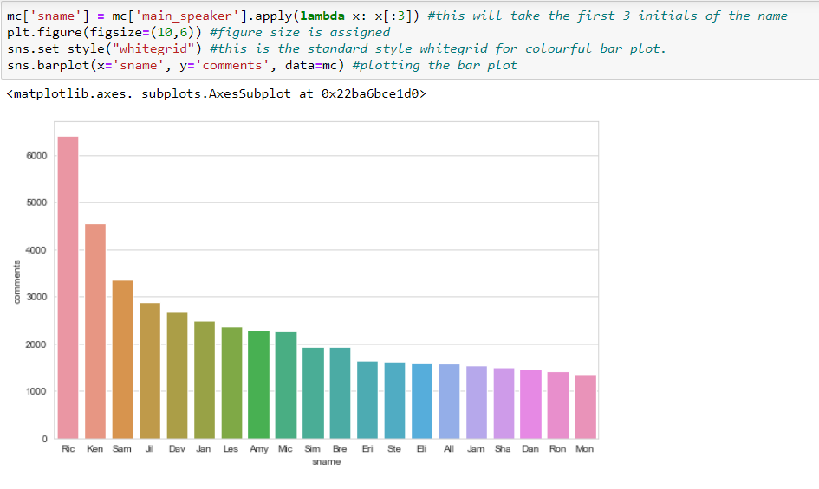
7) Which speaker has the most number of comments?

Slide 12
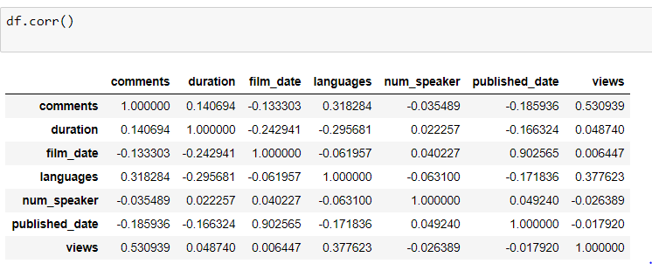
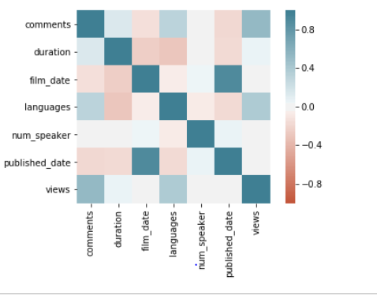
STATISTICAL ANALYSIS
Finding correlation among various factors

Slide 13
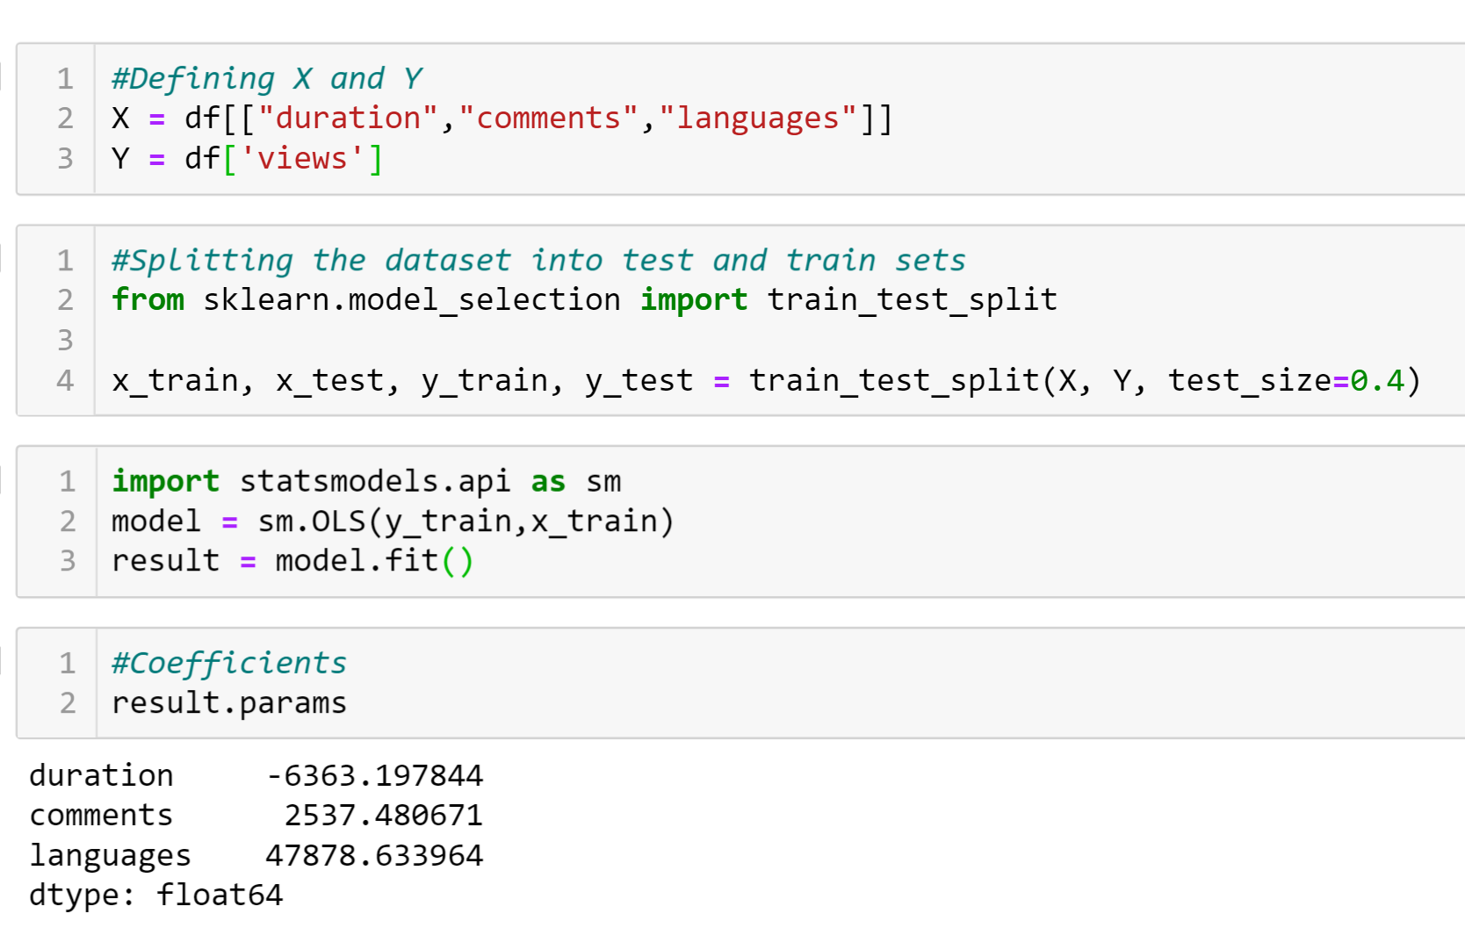
MULTIPLE LINEAR REGRESSION MODEL

Slide 14
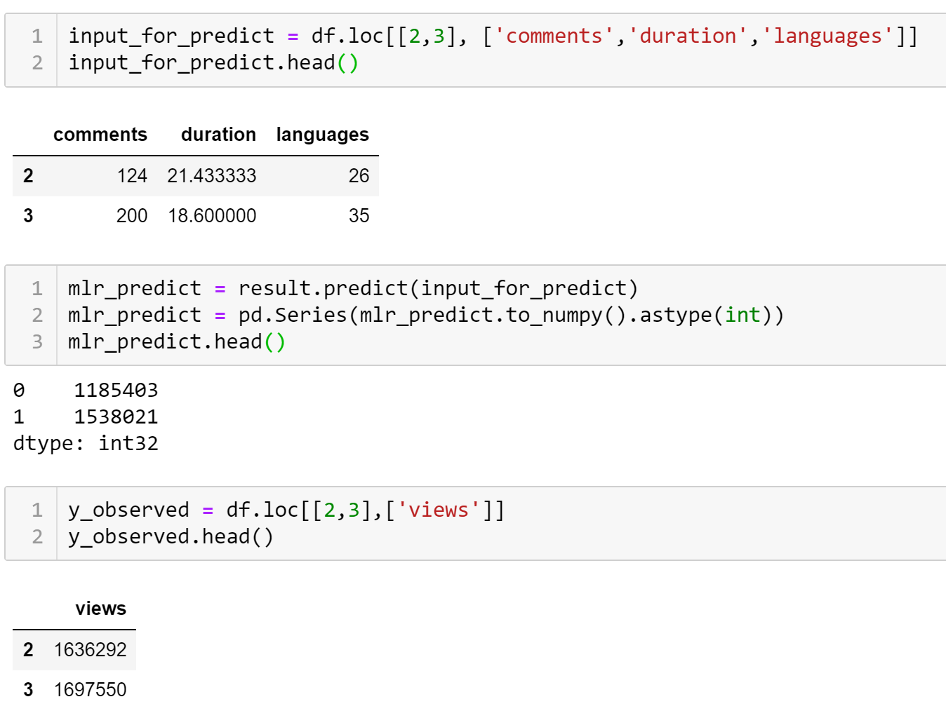

Slide 15
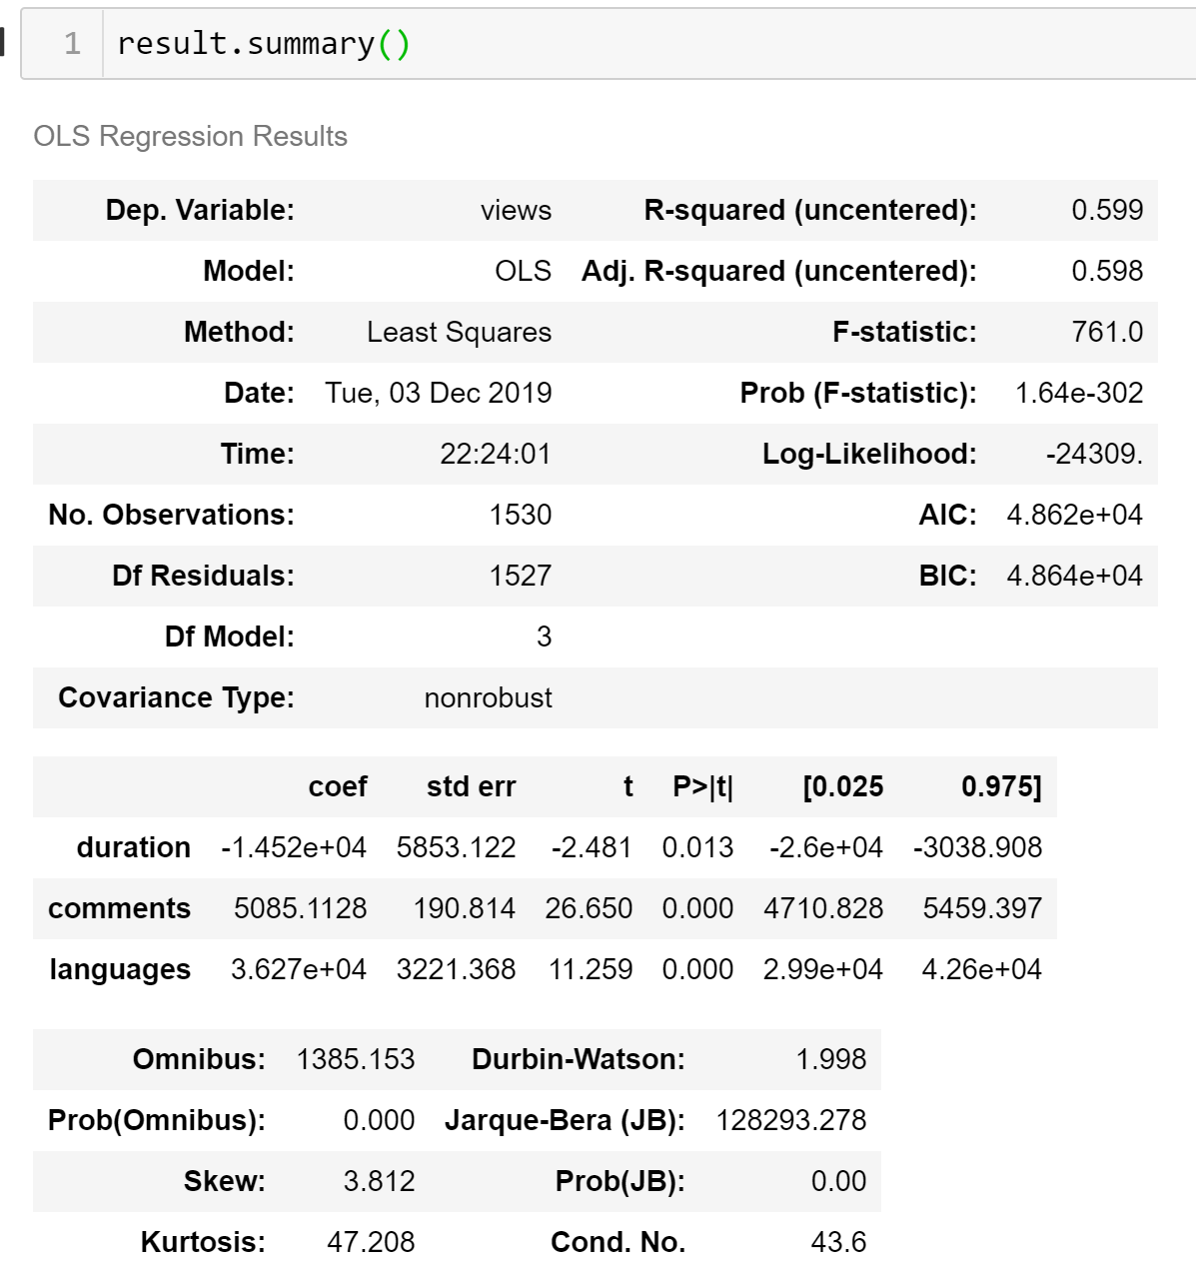

Slide 16
CONCLUSION
p-value ≤ 0.05 indicates strong evidence against the null hypothesis, so you reject the null hypothesis.(i.e., there is some significant difference between the variables considered)
Number of Comments and Languages are positively associated with the Views. Whereas, Duration is negatively associated with the Views.
R-squared score is 0.599, which means that this model explains 60% of the total variance.
We could see from our linear regression model that comments, languages and duration are the factors affecting number of views a video will get.

